Slide 1
Part 1: MIPS Machine Instruction Set
一、https://www.icourse163.org/learn/HUST-1003159001
5.5、MIPS Instruction Overview 5.6、MIPS Instruction Details
二、Understand the sort.asm program and successfully run it in MARS
三、Referring to examples and the "MIPS32 Instruction Manual. PDF", translate the following 8 assembly instructions into 32-bit machine instructions
四、Convert sort.asm to sort.hex using MARS's Dump memory function
五、Self study Chapter 4.
addi $s1,$zero,28
sw $s3, 128($s1)
Add $s0,$zero,$zero
syscall
lw $s4,128($s1)
slt $t0,$s3,$s4
100H:beq $t0,$0,sort_next (120H)
200H:bne $s0, $s1, sort_loop(220H)

Slide 2
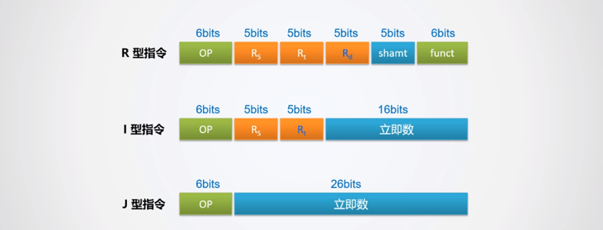
MIPS Instruction format
OP=000000..111111;0..63
R-type instruction：OP=0,FUNCT=00-43
I -type instruction：OP=04..43
J -type instruction：OP=02,03

Slide 3
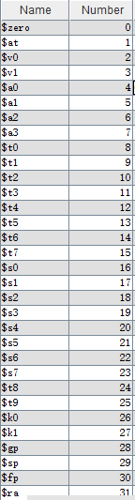
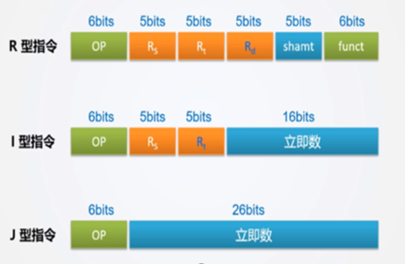
No. | instruction | OpCode | FUNCT | function | tyoe
 |  | decimal | decimal
1 | ADD $rd,$rs,$rt | 0 | 32 | R[rd] = R[rs] + R[rt] | R
2 | SLT $rd,$rs,$rt | 0 | 42 | R[rd] = (R[rs] < R[rt]) ? 1 : 0 | R
3 | ADDI $rt,$rs,imm | 8 | X | R[rt] = R[rs] + SignExt{imm} | I
4 | LW $rt,imm($rs) | 35 | X | R[rt] = M[R[rs]+SignExt{imm}] | I
5 | SW $rt,imm($rs) | 43 | X | M[R[rs]+SignExt{imm}] = R[rt] | I
6 | BEQ $rs,$rt,imm | 4 | X | if(R[rs]==R[rt]) PC=PC+4+SignExt({imm,00}) | I
7 | BNE $rs,$rt,imm | 5 | X | if(R[rs]!=R[rt]) PC=PC+4+SignExt({imm,00}) | I
8 | SYSCALL | 0 | 12 | 停机 | R
examples：
①add $16,$0,$at
0,0,1,16,0,32
000000,00000,00001,
10000,00000,100000
0x0001,8020
②addi $s0,$0,-1
8,0,16,-1
001000,00000,10000
11111111,11111111
0x2010,ffff
8 machine instructions formats and functions
General Register Number

Slide 4
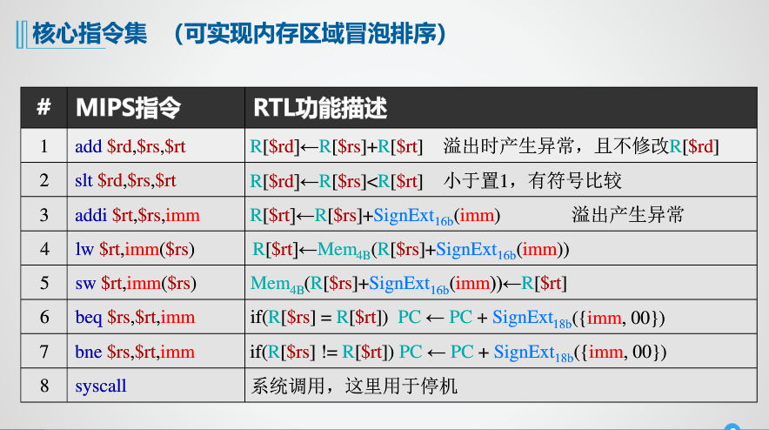

Slide 5
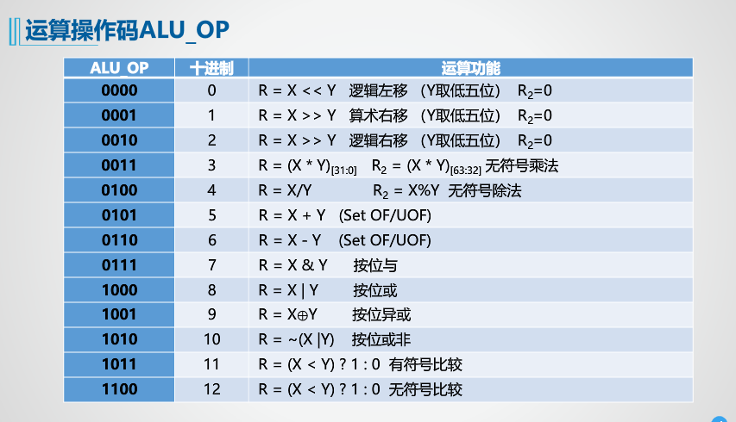
Alu_op signal

Slide 6

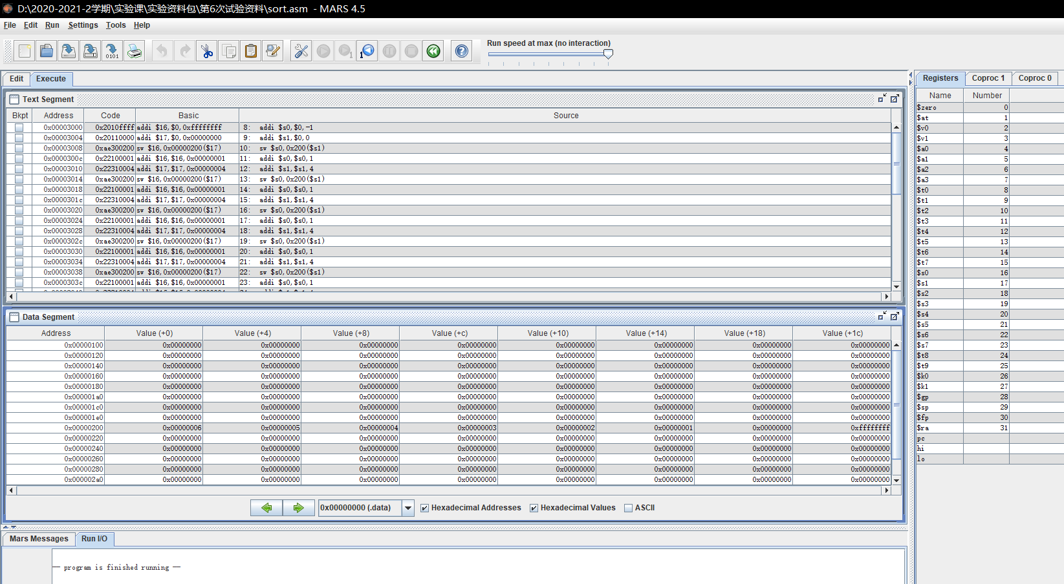
Register alias， number ，value
code segment, Byte addr, instruction, assembler instruction
data segment Base Address offset Value sort.hex results
Message Value Display Method
MIPS assembly simulation tool MARS. Note that the instruction memory (TEXT field) and data memory (DATA field) in the Haval structure are separated, and the starting address can be set；https://www.bilibili.com/video/BV1au411y7qq

Slide 7
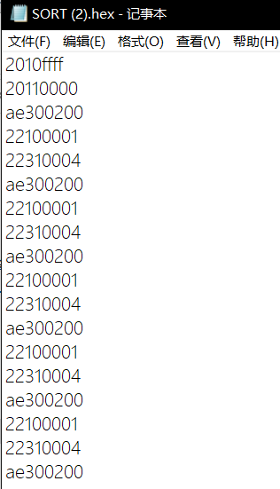
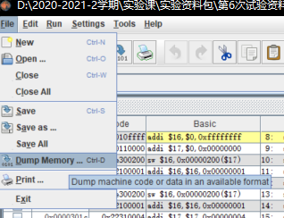
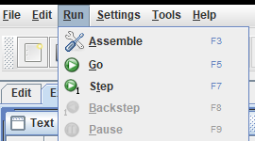
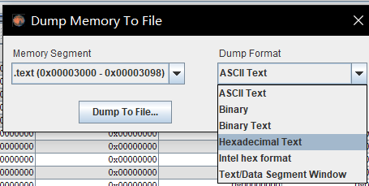
MARS、assembly、 go、 and step can debug and run instructions,Dump memory converts machine language programs in memory into a hexadecimal file *.hex, which can be loaded into Logisim's ROM for execution by the MIPS CPU (pay attention to the address range)

Slide 8

单选题
1分
What is the purpose of the MIPS assembly simulation tool MARS?
A
To debug and run instructions, and convert machine language programs into hexadecimal files
B
To design hardware for MIPS processors
C
To simulate the behavior of a multi-cycle MIPS CPU
D
To create graphical representations of MIPS instructions
提交

Slide 9
Part 2: Single cycle MIPS CPU
一、self-study https://www.icourse163.org/course/HUST-1205809816 Chapter 6
6.1、Single cycle MIPS framework
6.3、Single cycle MIPS CPU design (8 instructions)
二、Self study Chapter 5 P87-P90
三、Refer to the textbook 5.3 ,Single cycle MIPS processor design experiment in the template file, Verificate on TOUGE platform:
1、Single cycle hardwired controller
2、Single cycle MIPS (hard wired)
3、Run successful test program:sort.hex
四、Instruction Extension
Implement verification and instructions
Implement verification andi instructions
Implement verification j instruction
Other R、I、J type instructions can also be used

Slide 10
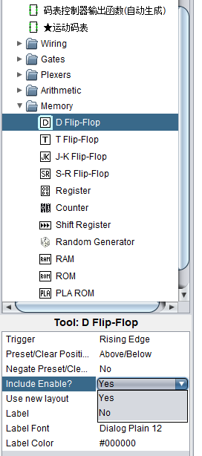
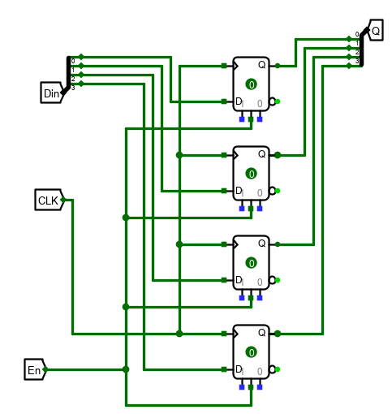
4bit/16bit D Register
4bit D Register：use device library and modification of device parameters，Be familiar with the use of CLK pin of sequential circuit.
点击添加文本
Next state
Current state
点击添加文本
点击添加文本
点击添加文本

Slide 11
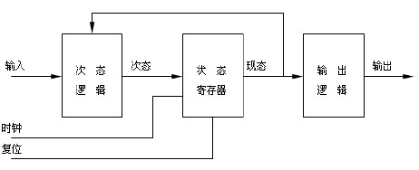
16位D寄存器：熟悉时序电路的封装和调用
4、4bit/16bit D Register，BCD Counter，4-digit decimal counter
1-digit decimal counter：FSM
FSM(Finite state machine)：Status register，State transition Combined circuit，Output Combined circuit；
第一类，若输出逻辑只和状态有关而与输入无关，则称为Moore状态机
第二类，输出逻辑不仅和状态有关而且和输入有关系，则称为Mealy状态机
点击添加文本
点击添加文本
转 换
点击添加文本
组合逻辑电路
组合逻辑电路
点击添加文本
Moore状态机

Slide 12
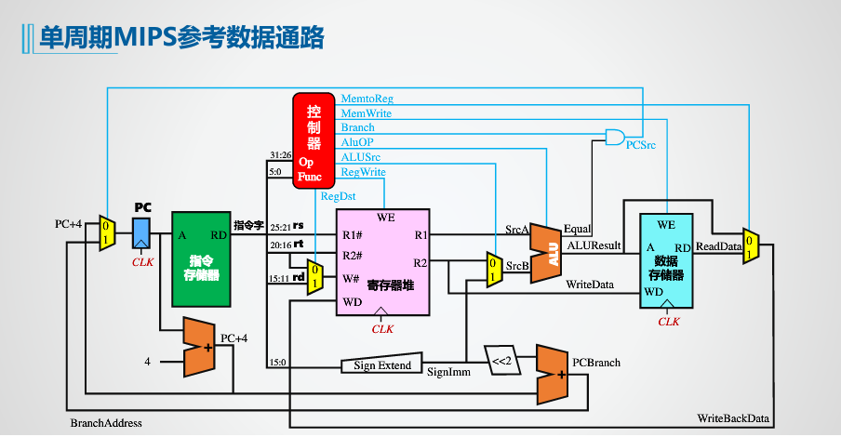
计算机总结构图
ADD $rd,$rs,$rt
SLT $rd,$rs,$rt
ADDI $rt,$rs,imm
LW $rt,imm($rs)
SW $rt,imm($rs)
BEQ $rs,$rt,imm
BNE $rs,$rt,imm
SYSCALL
branch=Beq&Equal or Bne&~Equal
branch
次态
次态
次态

Slide 13
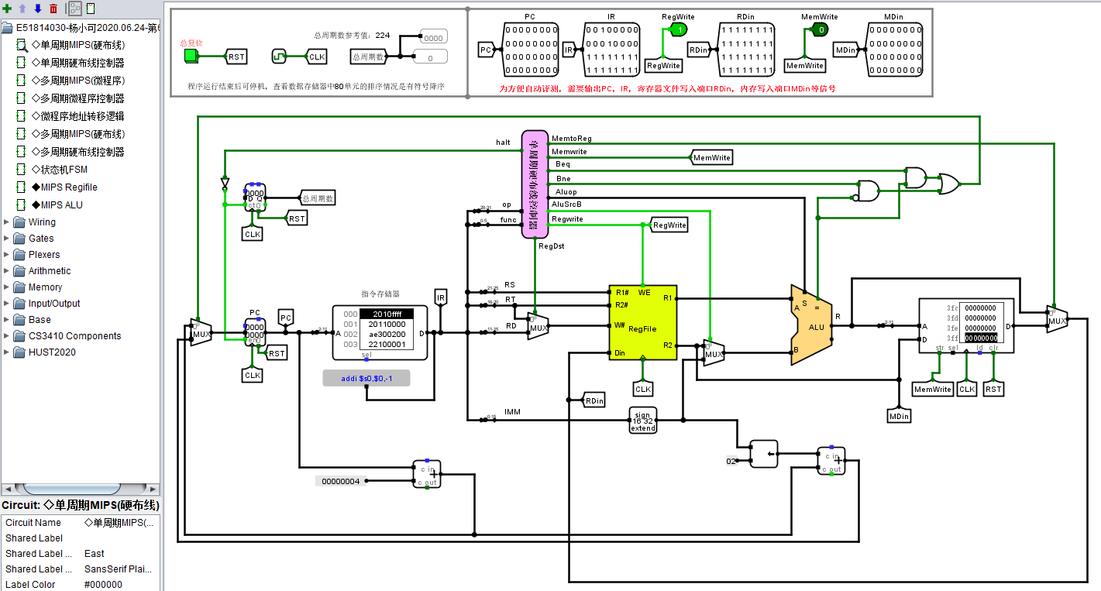

Slide 14
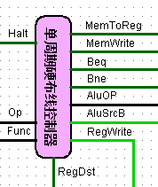
branch=Beq&Equal or Bne&~Equal
branch
Halt

Slide 15
Controller Design
using universal tables:
12 in: OP+FUNC
12 outputs: all output control signals
Combinational logic circuit Universal table only need 8 rows;

Slide 16
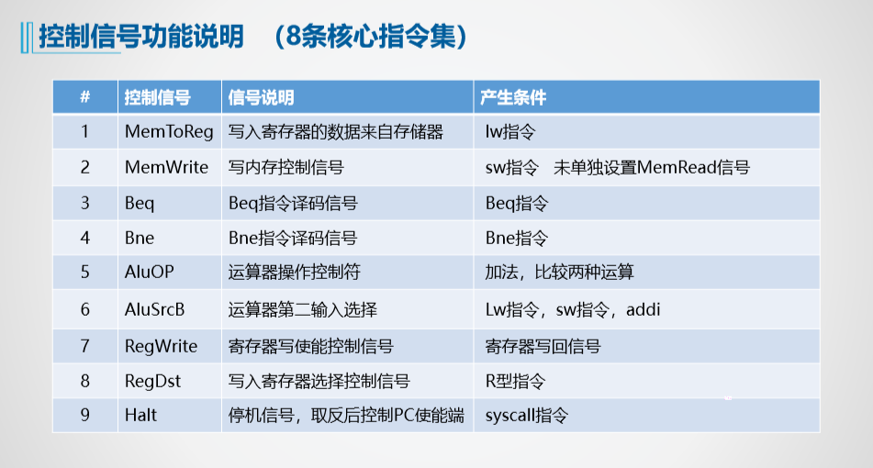
MIPS CPU中的寄存器使用

Slide 17
8条指令指令格式和功能
opcode | 指令助记符 | RTL 功能描述 | 备注
0 (func:32） | add $rd, $rs, $rt | R[$rd] ←R[$rs]+R[$rt] | RegDest，Aluop=0101，Regwrite
0 (func:12) | syscall | 系统调用，PC不变 | Halt
0 (func:42) | slt $rd, $rs, $rt | R[$rd]←R[$rs]<R[$rt] ，小于置1，有符号比较 | RegDest，Aluop=1011,Regwrite
04 | beq $rs, $rt, imm | If (R[$rs]=R[$rt]), PC←PC+4+SignExt_{18b}({imm左移2位}) | Beq，（imm是字地址，左移2位转换成字节地址）
05 | bne $rs, $rt, imm | If (R[$rs]!=R[$rt]), PC←PC+4+SignExt_{18b}({imm左移2位}) | Bne，（imm是字地址，左移2位转换成字节地址）
08 | addi $rt, $rs, imm | R[$rt] ←R[$rs]+SignExt_{16b}(imm） | AluSrc, Aluop=0101，Regwrite
35 | lw $rt, imm($rs) | R[$rt] ←Mem (R[$rs]+SignExt_{16b}(imm)之和右移2位) | AluSrc，Aluop=0101, MemToReg， Regwrite,（rs和imm都是字节地址，加法和要右移2位转换成字地址才能访问数据M）
43 | sw $rt, imm($rs) | Mem (R[$rs]+SignExt_{16b}(imm)之和右移2位)←R[$rt] | AluSrc,Aluop=0101, MemWrite，（rs和imm都是字节地址，加法和要右移2位转换成字地址才能访问数据M）
备注：跳转指令偏移地址imm求解公式：目标字节地址=当前地址+4+imm*4

Slide 18
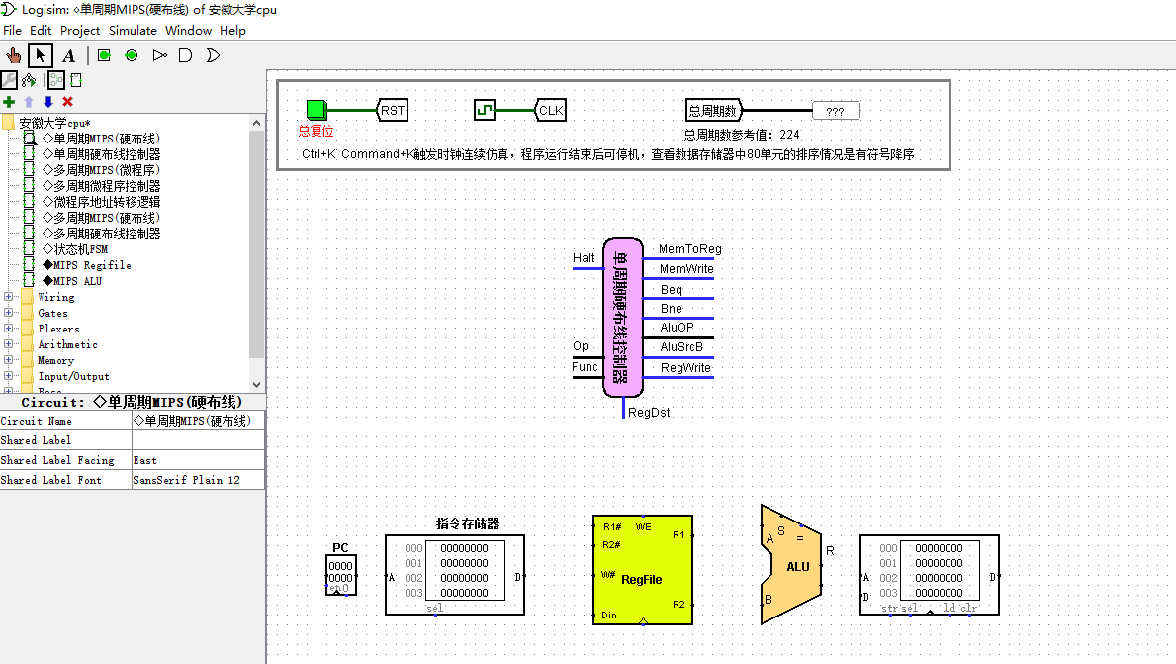
Single cycle MIPS CPU

Slide 19
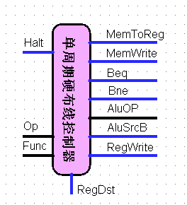
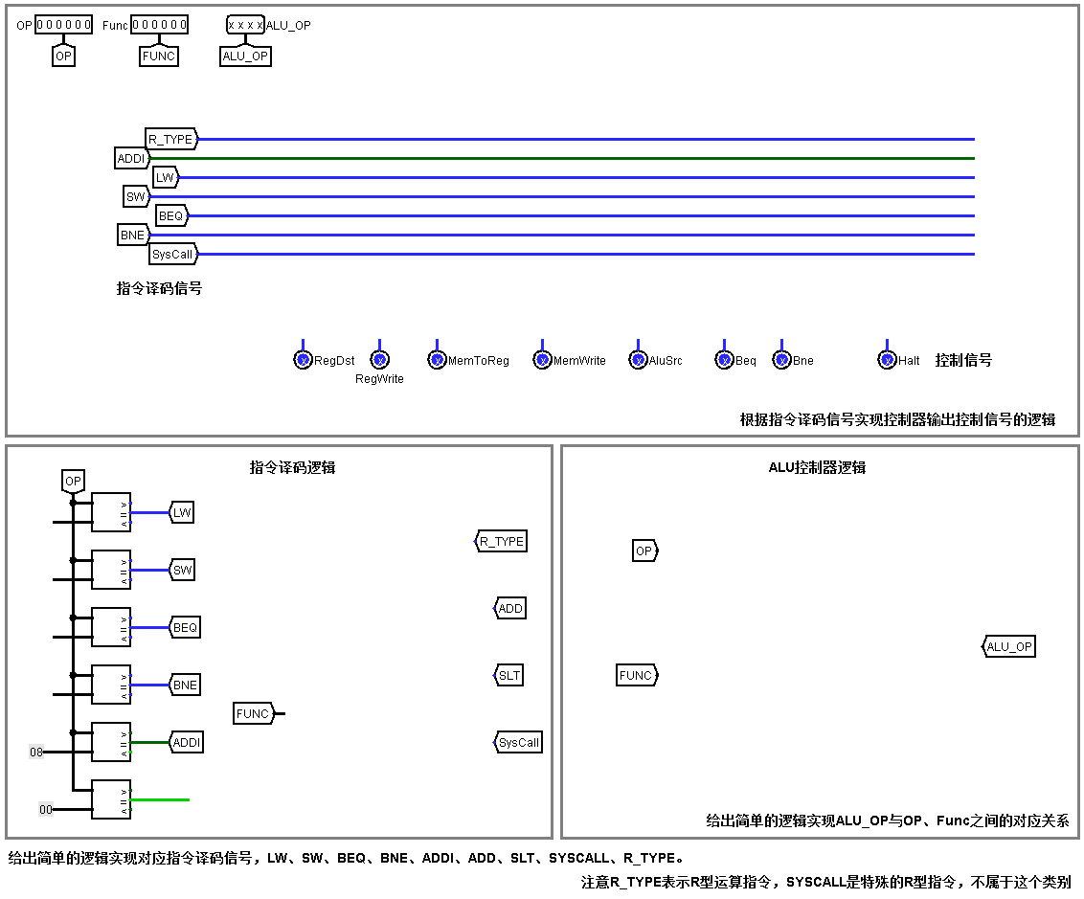

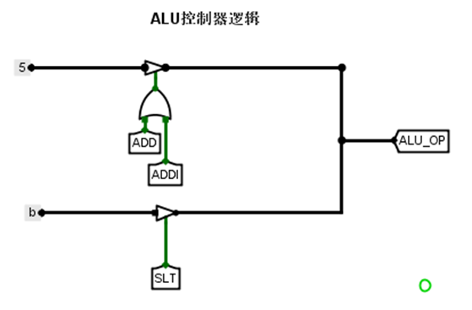
Controller circuit
Input pin
Output pin
这部分产生ALU_OP控制信号，
用三态门电路易于指令扩展

Slide 20
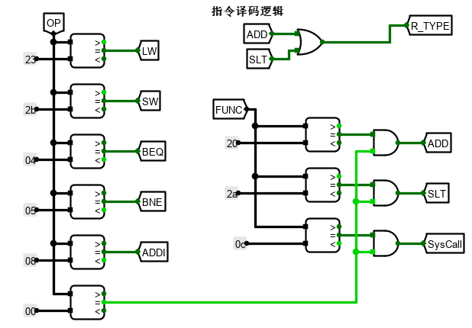
The instructon decoder converts the OP field and FUNC field into an instruction tunnel: The ID use comparator. R_ Type=1 indicates a R-type instruction(except syscall).

Slide 21
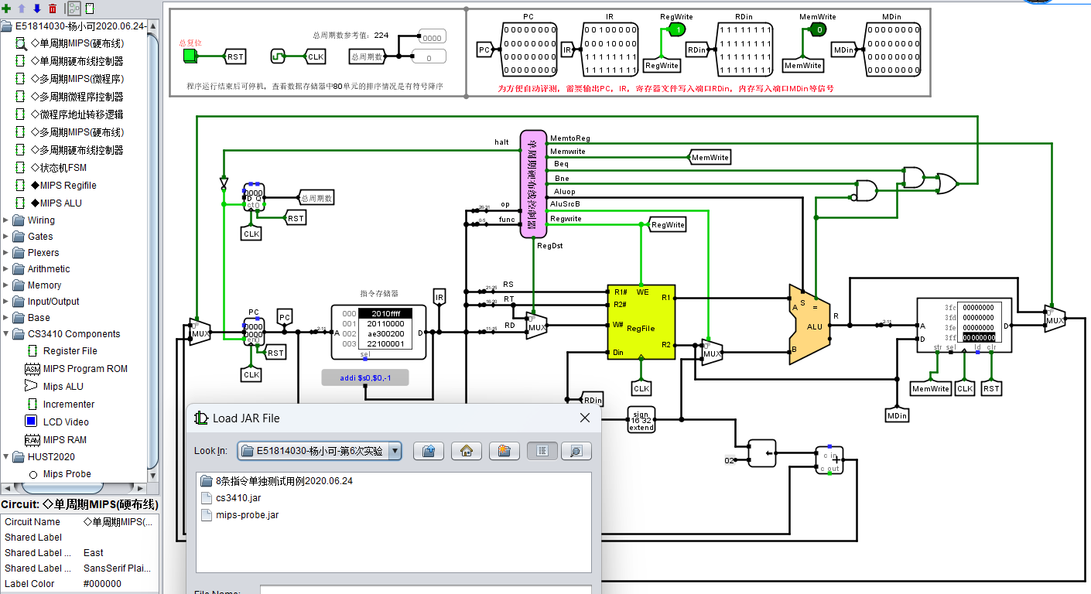
Load cs3410.jar，mips-probe.jar
cs3410.jar is an extended component library designed and shared by Cornell University for MIPS circuits, including the register group, ROM, RAM,ALU,display screen of the MIPS CPU

Slide 22
单选题
1分
What is the purpose of the cs3410.jar library in the MIPS CPU design?
A
To implement verification instructions
B
To provide an extended component library for MIPS circuits
C
To modify the instruction decoder
D
To add a MUX in front of the PC
提交

Slide 23
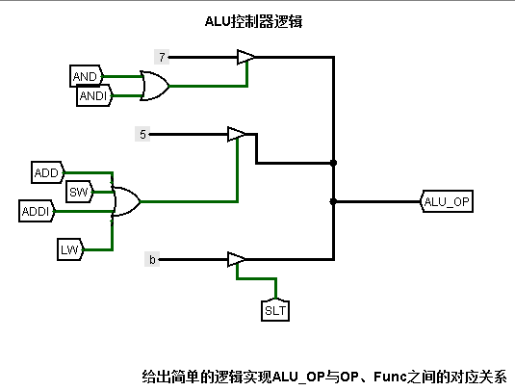
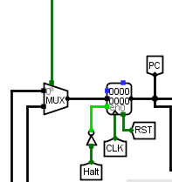
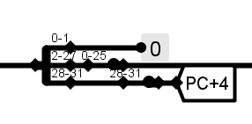
Instruction Extension 1、Implement verification and instructions 2、Implement verification andi instructions Modify the instruction decoder and ALU control logic， or add two rows in the universal table 3、Implement verification j instruction You must modify the instruction splitter, add the j instruction jump address circuit, j control signal, add a MUX in front of the PC, etc Other R、I、J type instructions can also be used
JMPADDR
instr_index
pc+4
PCBranch
JMPADDR= PC31..28 || instr_index || 00 PC=PC+4
PCBranch=PC+4+IMM16<<2

